Slide 1
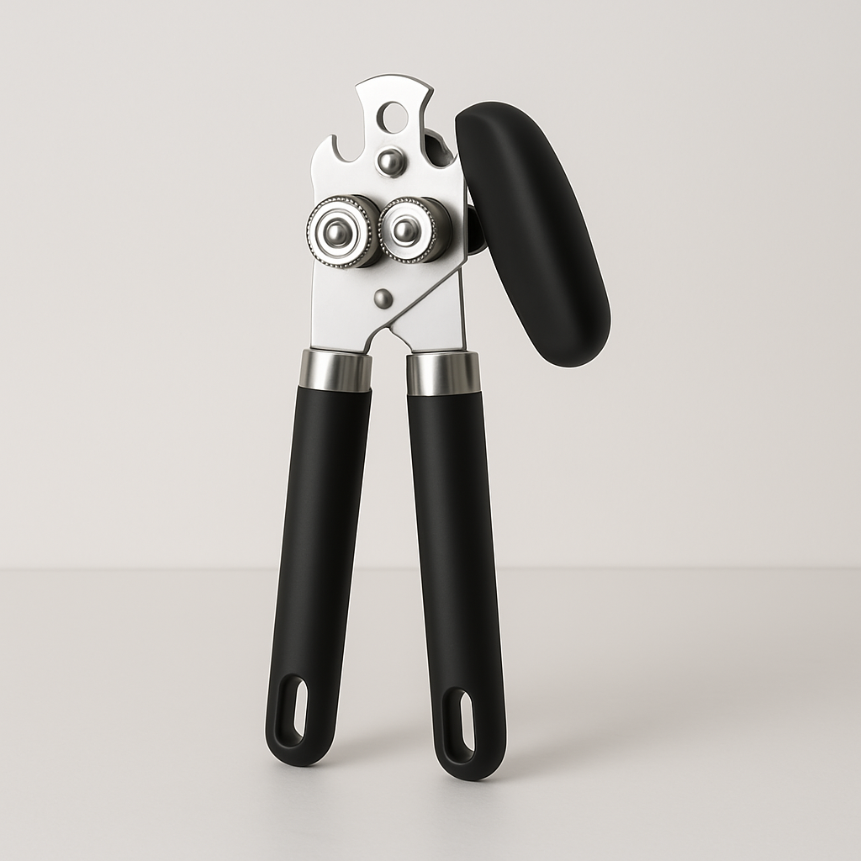
Introducing the Ultimate Can Opener
Unveiling our latest innovation in kitchen appliances, designed with sophistication and precision to enhance your culinary experience.

Slide 2
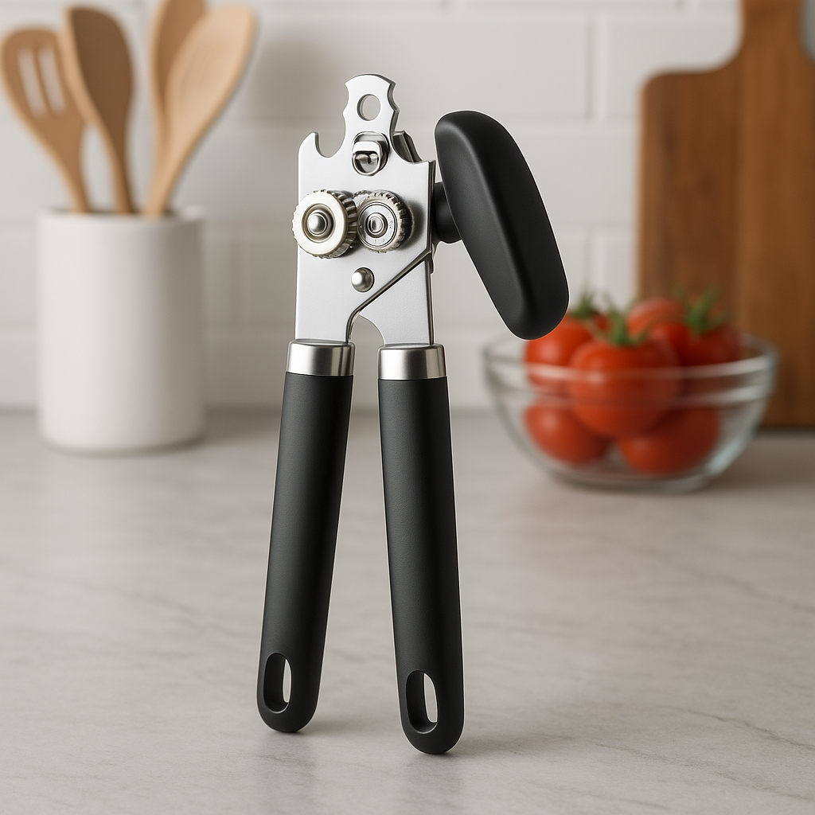
Crafted for Excellence
Experience unparalleled quality and durability with our premium can opener, engineered for effortless cutting and seamless operation.

Slide 3
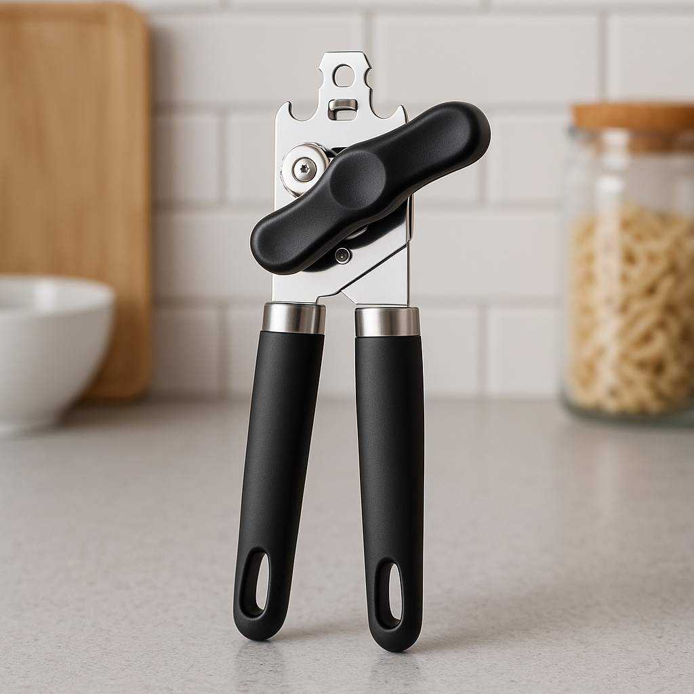
Sleek Design Meets Functionality
Our can opener combines modern aesthetics with practical functionality, ensuring it stands out in any kitchen setting.

Slide 4
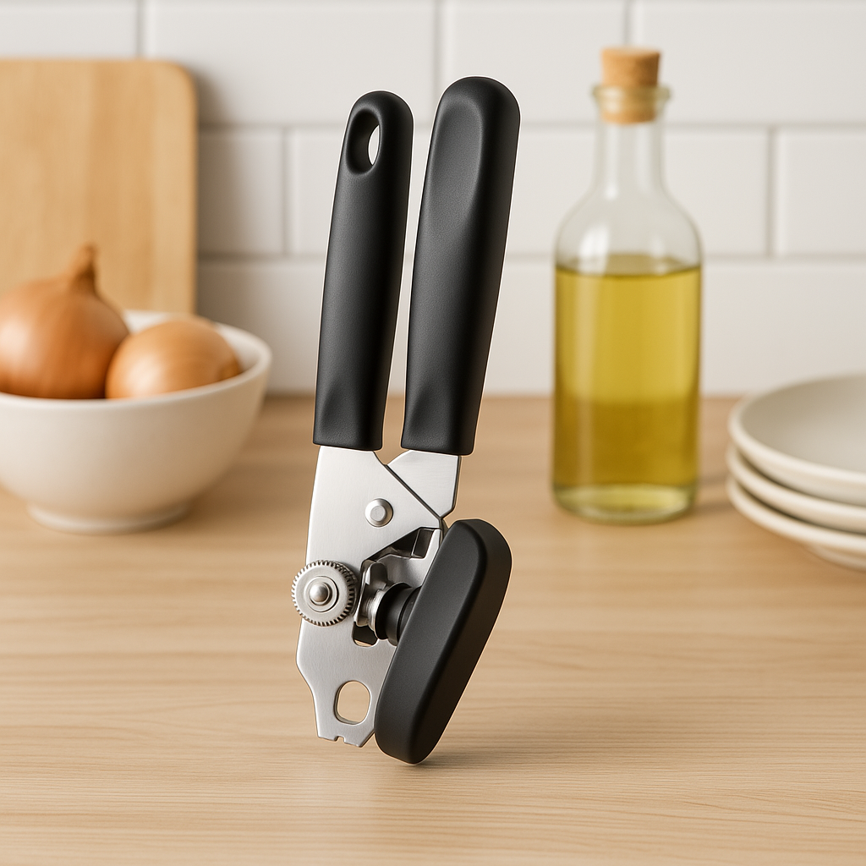
Elevate Your Kitchen Experience
Join the ranks of culinary enthusiasts who choose our can opener for its superior design and performance, reinforcing our brand as a leader in premium kitchen solutions.

